Slide 1

MEDIROUTE: AUTONOMOUS MEDICAL SUPPLY DELIVERY ROBOT FOR HOSPITALS
Department of Mechanical Engineering
BHUVANAN M | ARAVINTH R | AMBIKA B | DHARANESHWARAN B
KNOWLEDGE INSTITUTE OF TECHNOLOGY – SALEM
TEAM NO : 9

Slide 2
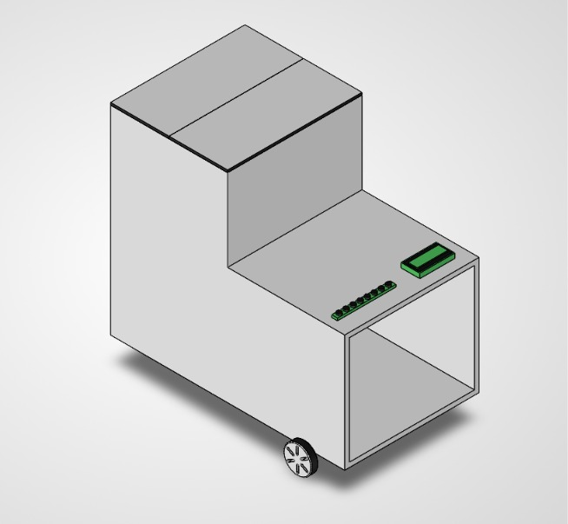
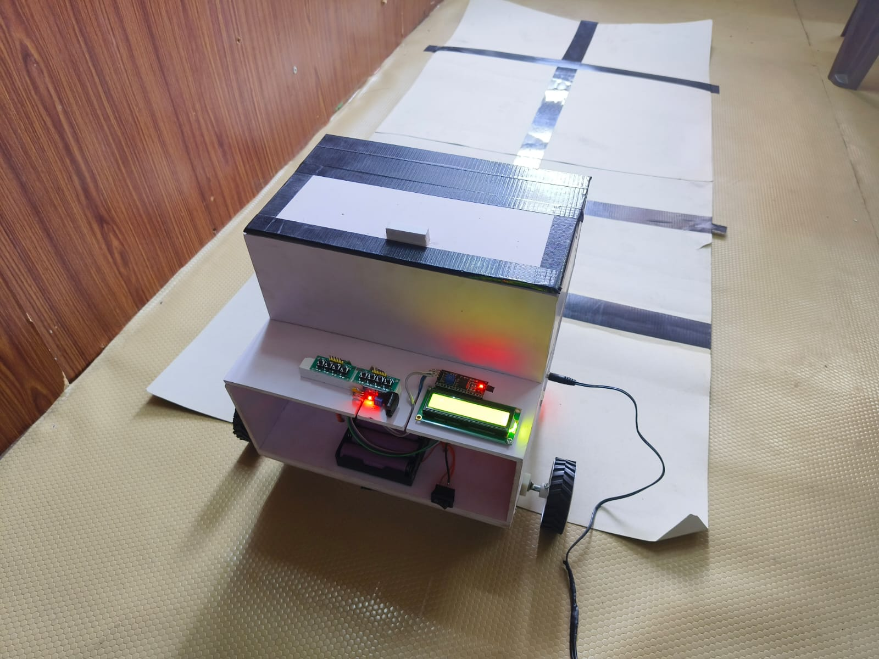
KNOWLEDGE INSTITUTE OF TECHNOLOGY
Mediroute : Autonomous Medical Supply Delivery
Robot for hospitals
Objective: To transport medical supplies autonomously between hospital stores, nursing stations and wards, using low-cost sensor-guided navigation without manual intervention.
Solution: An Arduino UNO-based robot combining IR line-following, ultrasonic obstacle detection, and dual-motor differential drive to carry payload safely along a fixed corridor route.
ISOMETRIC VIEW
PROTOTYPE
2

Slide 3
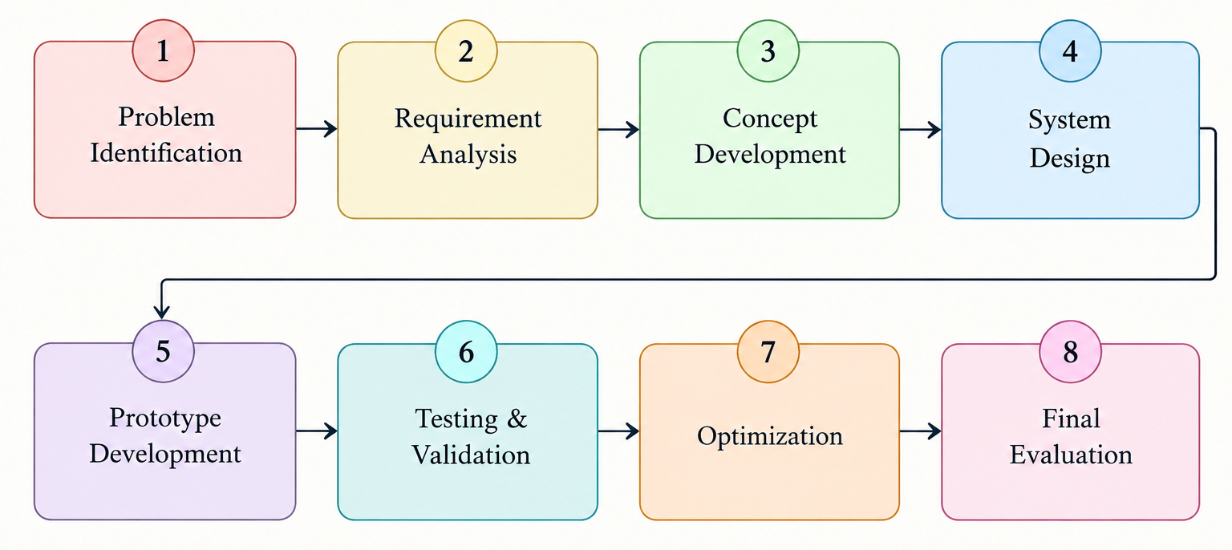
KNOWLEDGE INSTITUTE OF TECHNOLOGY
Engineering Design Process
3

Slide 4
KNOWLEDGE INSTITUTE OF TECHNOLOGY
Process Table
Phase
Activity
Outcome
Line Following
Dual IR sensors read the reflective tape path; Arduino computes error e = SL - SR
Motors steer proportionally (VL/VR = Vbase +/- Kp.e) to stay on path
Obstacle Detection
HC-SR04 ultrasonic sensor continuously measures distance ahead
Robot stops automatically when an obstacle is within 15 cm
Differential Drive
L298N driver controls two DC gear motors independently
Smooth turning and straight-line corridor travel
Payload Handling
Dedicated compartment carries the medical supply load
Stable up to 400 g; wheel slip observed beyond 500 g
Power Management
7.4V Li-ion pack regulated via 7805 to a stable 5V logic rail
~40 minutes of continuous operation per charge
4

Slide 5
KNOWLEDGE INSTITUTE OF TECHNOLOGY
List of Activities
Literature Survey: Reviewed existing autonomous hospital delivery robots, navigation methods, and obstacle avoidance techniques.
Component Selection & Procurement: Selected Arduino UNO, IR sensors, HC-SR04 ultrasonic sensor, L298N motor driver, DC gear motors, Li-ion battery, LCD, and other components based on cost and compatibility.
Mechanical Design & Fabrication: Designed and fabricated the two-tier robot chassis with motor, battery, sensor, and medical storage compartment arrangements.
Circuit Design & Assembly: Interfaced the sensors, motor driver, motors, LCD, push button, and Arduino UNO and completed the prototype wiring.
Firmware & Website Development: Developed the Arduino control program for zone selection, line following, obstacle avoidance, motor control, and return-to-home operation, along with the MediRoute hospital dispatch website.
Prototype Integration & Testing: Integrated the complete system and validated obstacle detection, navigation, turning, payload carrying, battery performance, and delivery operation.
5

Slide 6
KNOWLEDGE INSTITUTE OF TECHNOLOGY
Activity Duration Table
Activity ID
Task Description
Duration
A1
Requirement Study and Component Selection
1 Week
A2
Chassis Design and Fabrication
2 Weeks
A3
Sensor Wiring and Motor Driver Integration
1 Week
A4
Control Logic Programming (Line-Following + Obstacle Avoidance)
1 Week
A5
Corridor Testing, Data Recording and Analysis
2 Weeks
6

Slide 7
KNOWLEDGE INSTITUTE OF TECHNOLOGY
Activity Precedence Table
Activity
Preceded By
Logic
Chassis Fabrication
Requirement Study
Construction starts after component selection and design finalization
Sensor Integration
Chassis Fabrication
Sensors mounted only after chassis structure is complete
Corridor Testing
Sensor Integration
Testing starts once control logic and sensors are fully operational
Data Analysis
Corridor Testing
Performance evaluation done after sufficient trial data is collected
7

Slide 8
KNOWLEDGE INSTITUTE OF TECHNOLOGY
Glossary
Line Following:
Robot navigation technique that tracks a marked path using reflected IR light intensity.
Differential Drive:
Steering method where two independently driven wheels create turns by varying relative speed.
Proportional Control:
Control law where motor correction is proportional to the sensor deviation error (e = SL - SR).
HC-SR04:
Ultrasonic distance sensor used to detect obstacles ahead of the robot in real time.
L298N:
Dual H-bridge motor driver module that controls direction and speed of two DC motors.
Payload:
The medical supply load carried in the robot’s onboard storage compartment.
8

Slide 9
KNOWLEDGE INSTITUTE OF TECHNOLOGY
Science Principles
Reflectance & Optics (IR Sensing):
Dark and light surfaces reflect infrared light differently, allowing IR sensors to distinguish the guide path from the floor.
Closed-Loop Feedback Control:
Continuous sensor error correction (e = SL - SR) adjusts motor speed to keep the robot centred on the path.
Acoustic Ranging (Ultrasonic):
Sound wave time-of-flight measurement calculates distance to obstacles for collision avoidance.
Traction & Load Limits:
Wheel-floor friction limits determine the maximum stable payload before slip occurs under motor torque.
9

Slide 10
KNOWLEDGE INSTITUTE OF TECHNOLOGY
Concept Rules and Laws
Proportional Steering Law: VL/VR = Vbase -/+ Kp.e (e = SL - SR) — larger sensor error produces stronger corrective turning.
Ohm's Law (Power Sizing): V = I x R — used to size the voltage regulator and current draw for motors and logic circuits.
Distance-Time Law (Ultrasonic): d = (v_sound x t) / 2 — echo travel time converted into obstacle distance.
Friction/Traction Limit: Maximum stable payload is limited by wheel-floor friction before slip occurs.
Battery Discharge Rule: Runtime decreases as load current increases; battery capacity (mAh) sets the endurance limit.
10

Slide 11
KNOWLEDGE INSTITUTE OF TECHNOLOGY
Constants and Variables
CONSTANTS
VARIABLES
Chassis Dimensions: approx. 30 x 20 x 20 cm
(two-tier)
Obstacle Stop Distance: 15 cm
(ultrasonic threshold)
Battery Endurance: ~40 minutes continuous run
Max Rated Payload: 400 g
(500 g causes wheel slip)
Prototype Fabrication Cost: Rs. 2,820
Motor Supply Voltage: 12V DC (via L298N driver)
Sensor Error (e = SL - SR): Changes with path deviation
Motor Speed (VL, VR): Adjusts with proportional control
Distance to Obstacle: Varies with corridor obstacles
Payload Mass: Depends on medical supply load
Battery Voltage: Drops over discharge cycle
11

Slide 12
KNOWLEDGE INSTITUTE OF TECHNOLOGY
Key Equations
System Logic Model
IR Path Sensing >> Error Calculation >> Proportional Steering >> Differential Drive >> Ultrasonic Override >> Safe Delivery
Line-Following Error: e = SL - SR (SL, SR = left and right IR sensor readings)
Motor Speed Control: VL = Vbase - Kp.e , VR = Vbase + Kp.e
Obstacle Distance: d = (v_sound x t) / 2 (t = ultrasonic echo return time)
Result: Reliable path tracking with automatic stop within 15 cm of obstacles, confirmed across repeated trials.
12

Slide 13
KNOWLEDGE INSTITUTE OF TECHNOLOGY
What-If Analysis
Q:
What if the line-following path has a sharp turn?
Larger sensor error increases proportional correction; beyond the Kp range the robot may momentarily lose the line and need re-centering.
Q:
What if an obstacle appears suddenly close to the sensor?
The ultrasonic threshold triggers an immediate stop at 15 cm, overriding line-following until the path is clear.
Q:
What if payload exceeds the rated 400 g?
Wheel traction is exceeded (observed at 500 g), causing slip and loss of navigation accuracy.
Q:
What if the battery voltage drops significantly?
Motor torque and speed fall, increasing steering error and reducing obstacle-response reliability near the ~40-minute mark.
13

Slide 14
KNOWLEDGE INSTITUTE OF TECHNOLOGY
Conclusion
The Mediroute: Autonomous Medical Supply Delivery Robot for Hospitals project successfully demonstrates a low-cost autonomous delivery system for transporting medical supplies within hospital corridors. The robot uses Arduino UNO-based control, IR line-following sensors, ultrasonic obstacle detection, and differential-drive motors to achieve reliable path tracking and safe navigation. The prototype provides contact-free delivery with a payload capacity of up to 400 g, operates for approximately 40 minutes, and automatically stops when an obstacle is detected within 15 cm. the system offers a practical and economical solution for small-scale hospital logistics. The project can be further enhanced through IoT-based real-time tracking, RFID-based ward identification, SLAM navigation, and multi-robot coordination.
Thank You
14

